Slide 1

STREET MEAT

Slide 2
Mission Statement Street Meat is an all-inclusive social bike group. We strive to advance bike and pedestrian safety and dignity and pride ourselves on removing the barriers to entry to cycling and create a welcoming community for anyone and everyone.

Slide 3
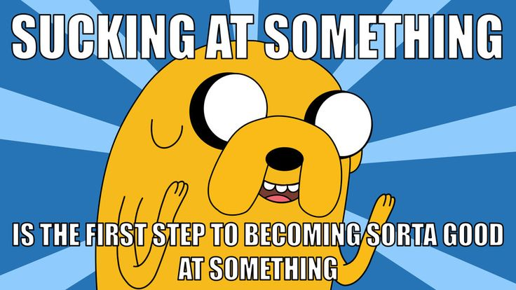

Slide 4
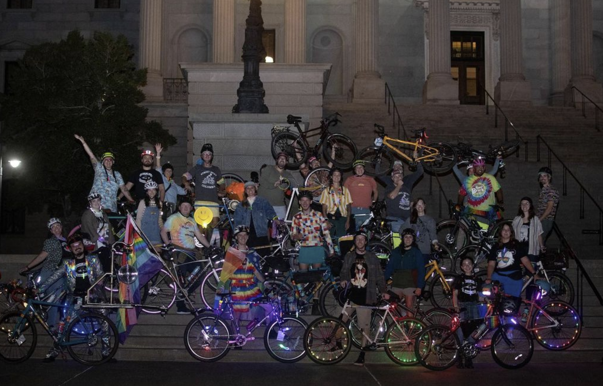
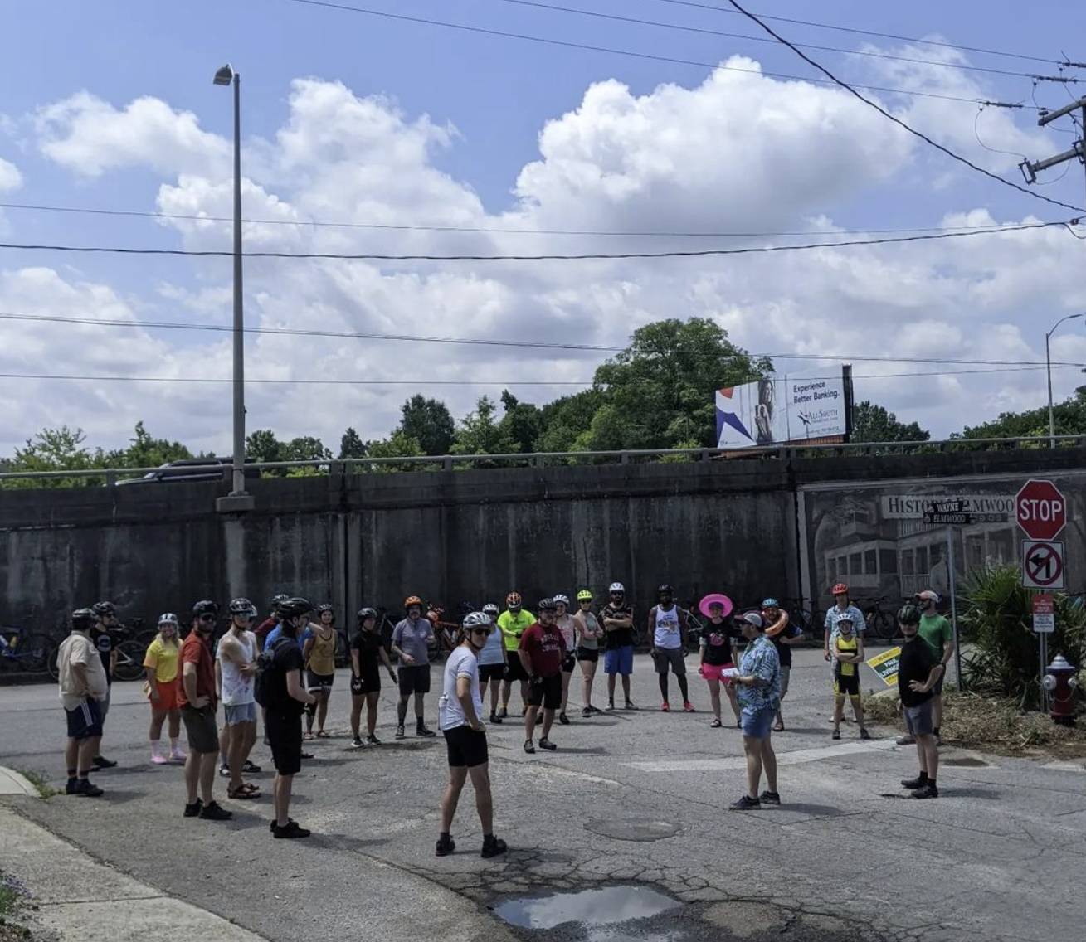
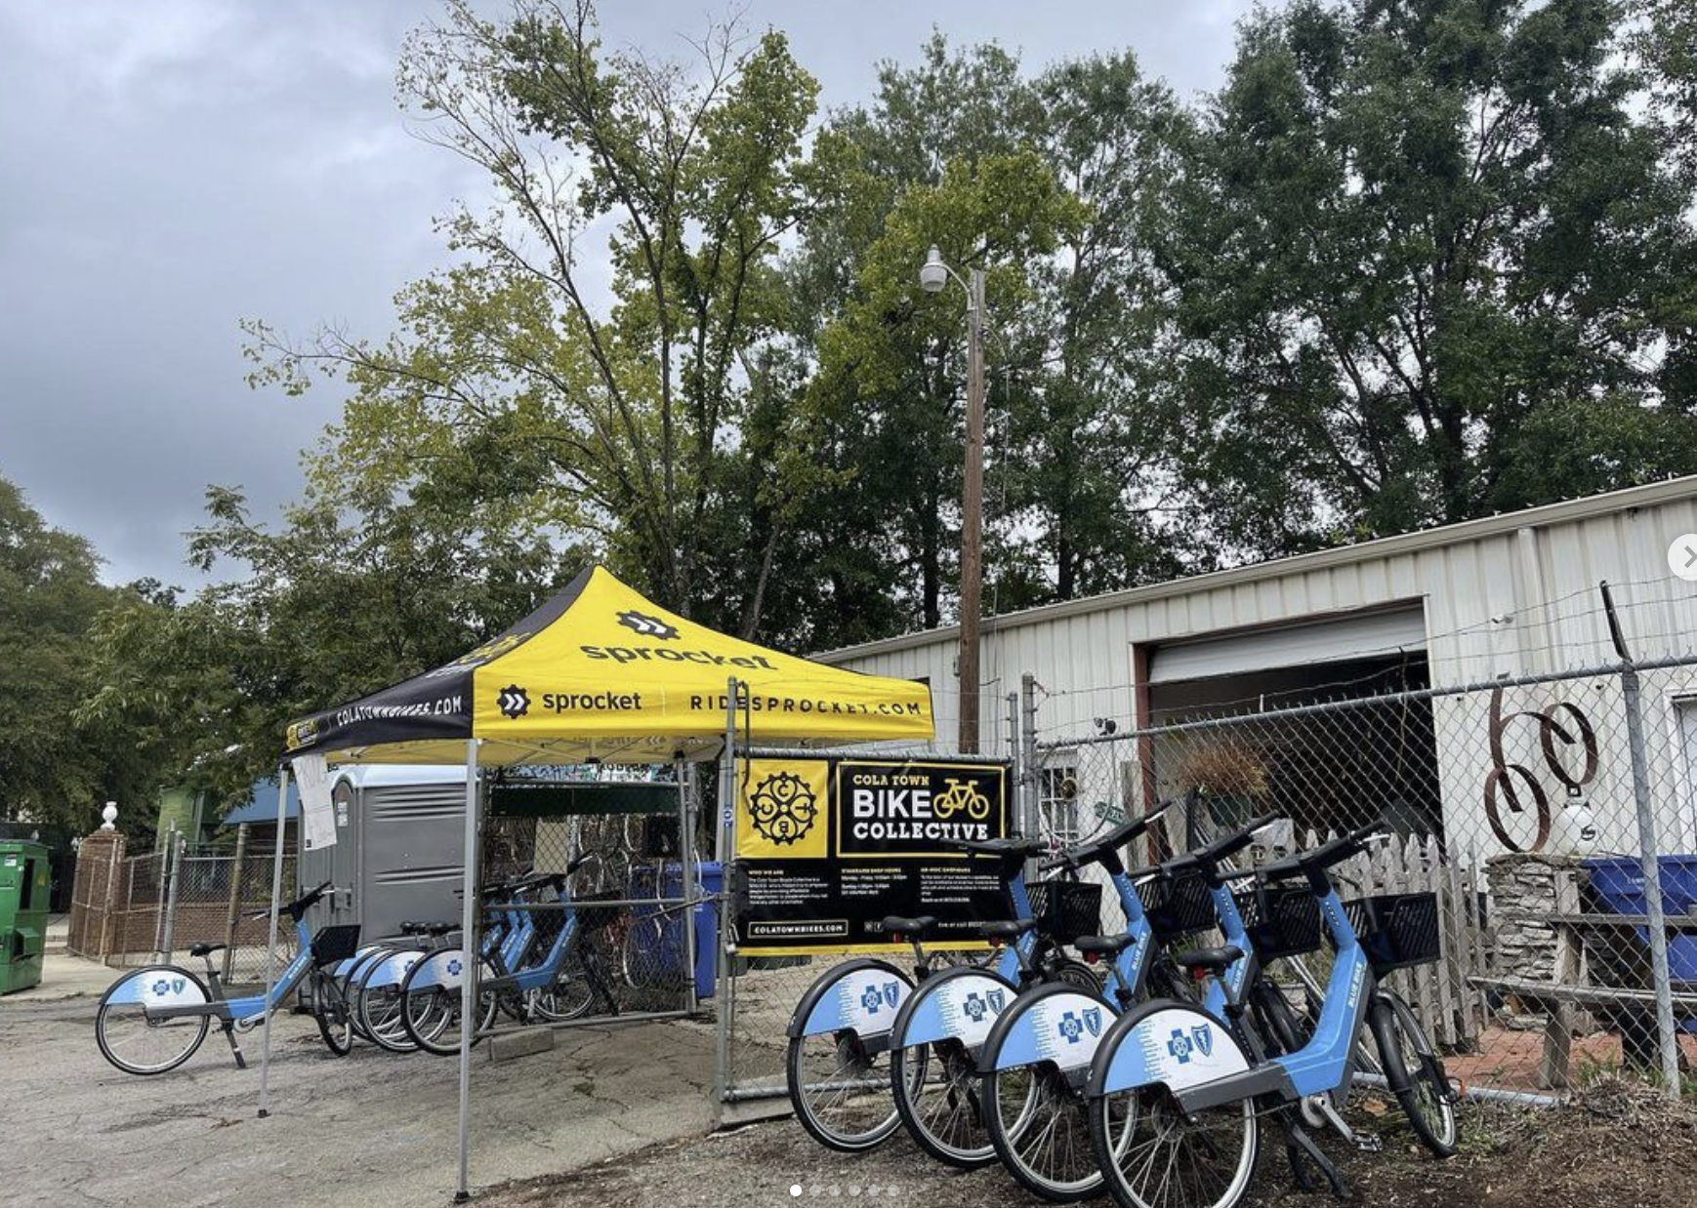
Accomplishments

Slide 5
Projects
Mardi Gras Parade - 2/18 – 11am
Street Meat ReOrg Kick off event – 5/23??
Bike Racks for local businesses
Picnic/Potluck ride
Poker Runs
Alley Cats Scavenger Hunts
Merch (stickers, shirts, fundraising, etc)

Slide 6
Phase 1

Slide 7



“Re”Organization
Events
Media
Community

Slide 8

Organizational Overlap
Shared Responsibility.
Odd Numbers to force majority votes.
Encourages communication across groups.
Small enough to make quick decisions.
Big enough to give representation.
Events
Community
Media

Slide 9
9 leadership positions
Administration(3)
Community(1) Member At Large(1) Events(1)
Member At Large(1) Media(1)
Member At Large(1)
Events
Member At Large
Member At Large
Administration
Community
Media
Member At Large

Slide 10
Community
Tuesday rides
Works with local businesses/sponsors
Helps manage the “people” side of the rides (new riders, safety, etc)

Slide 11

Community & Events Member At Large

Slide 12
Events
Organizing non-Tuesday Rides (out of town and etc)
Helps organize for parades/poker runs/alley cats/movie nights/etc

Slide 13

Events and Media Member at Large

Slide 14
Media
Art Projects
Shirts/Stickers/Promos

Slide 15

Media and Community Member at Large

Slide 16

Administration
Executive Director
Treasurer
Secretary

